Slide 1

POWER BI DASHBOARD PROJECT
DASHBOARD OVERVIEW
AMAZON SALES &
PRODUCT ANALYSIS
SALES
ORDERS
ITEMS
DASHBOARD
SALES DASHBOARD
Power BI Dashboard Project
PRODUCT DASHBOARD
Presented by: Divyabharathi .E
Tools Used: Power BI, Excel
01 / 16

Slide 2
PROJECT PRESENTATION
Introduction
An interactive view of Amazon
01
Sales
02
Product
sales and product performance.
Dashboard
Dashboard
This project is an Amazon Sales and
Product Analysis Dashboard.
The dashboard was created using
Microsoft Power BI.
Two pages. One interactive sales
and product view.
It helps analyze sales, orders, products,
brands, cities, and payment methods.
02 / 16

Slide 3
PROJECT PRESENTATION
Project Objectives
Σ
SALES & ORDERS
BI
PRODUCTS & DECISIONS
Analyze overall sales performance.
Identify top-performing products
and brands.
Monitor total orders and quantity.
Calculate Average Order Value.
Analyze sales by city and category.
Analyze cancelled and returned
orders.
Understand payment methods.
Create an interactive business
dashboard.
03 / 16

Slide 4
PROJECT PRESENTATION
Dataset Overview
The project uses an Amazon sales dataset.
01
TIME
02
PRODUCT
03
ORDER &
04
MEASURES
CUSTOMER
Order Date
Product Name
Order Status
Sales
Year
Category
City
Quantity
Month
Brand
Payment
Method
Product Price
04 / 16

Slide 5
PROJECT PRESENTATION
Tools & Technologies
BI
Power BI
XL
Excel
Data Visualization
Data Preparation
Dashboard Creation
Data Organization
KPI Analysis
Initial Data Analysis
Interactive Filters
Data Analysis
Preparation and initial analysis
DAX Measures
05 / 16

Slide 6





PROJECT PRESENTATION
Sales Dashboard
An overview of Amazon sales performance.
KPIs
Total Sales
Total Orders
Average Order
Cancelled
Total Quantity
Value
Orders
06 / 16

Slide 7
PROJECT PRESENTATION
Sales Analysis
The Sales Dashboard helps to analyze:
↗
SALES PERFORMANCE
SALES
Sales performance over time.
Monthly and yearly sales trends.
This helps
Category-wise sales.
businesses
Order status.
monitor their
Cancelled orders.
overall sales
Average order value.
Brand-wise performance.
performance.
07 / 16

Slide 8
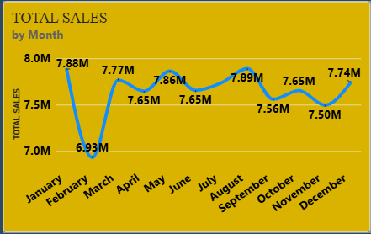
Sales performence
How are sales changing over time?
This line chart shows the sales trend over time.
It helps us identify whether sales are increasing, decreasing, or fluctuating during different periods.

Slide 9
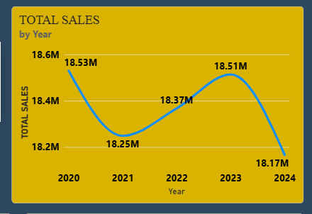
How are yearly sales changing?
This line chart shows yearly sales performance.
By comparing each year, we can understand the overall growth or decline in sales and identify the years with higher or lower sales.

Slide 10
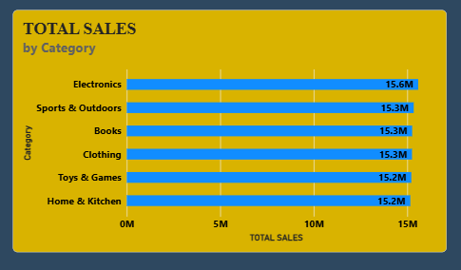
Which category has the highest sales?
This bar chart compares sales across different categories.
The category with the tallest bar represents the highest sales.
This helps us identify which category contributes the most to overall sales

Slide 11
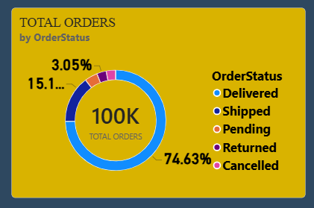
What is the order status distribution?
This donut chart shows the distribution of orders based on their status.
Each section represents a different order status, and the size of each section shows its contribution to the total number of orders.
It helps us understand the overall order fulfillment and cancellation situation.

Slide 12





PROJECT PRESENTATION
Product Dashboard
A product-level view of performance.
KPIs
Product
Returned
Total Products
Product Sales
Average
Quantity
Orders
Product Price
08 / 16

Slide 13
PROJECT PRESENTATION
Product Analysis
The Product Dashboard helps identify:
01
Top-selling
02
Products with
03
Top-performing
products.
higher quantities.
brands.
04
Cities generating
05
Customer
06
Returned orders.
higher sales.
payment
methods.
This helps businesses understand product demand and performance.
09 / 16

Slide 14
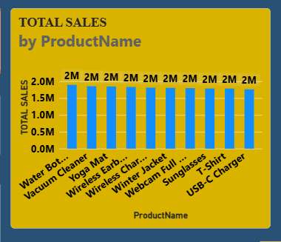
Product performance
Which product generated the highest sales?
This column chart compares the sales of different products.
The product with the tallest column has generated the highest sales.
This helps us identify the best-performing product based on sales.

Slide 15
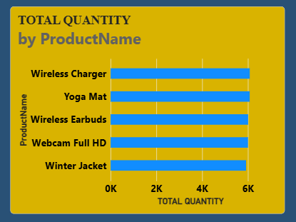
Which product sold the highest quantity?
This bar chart shows the quantity sold for different products.
The product with the longest bar represents the highest quantity sold.
It helps us identify which product has the highest demand.

Slide 16
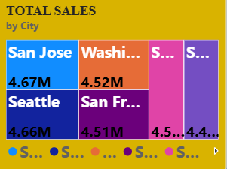
Which city generates the highest sales?
This treemap shows sales by city. The largest rectangle represents the city with the highest sales.
It helps us quickly compare the contribution of different cities to total sales

Slide 17
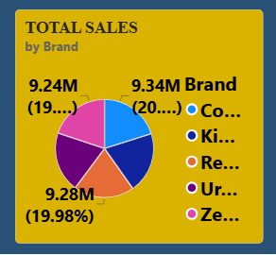
Which brand generates the highest sales?
This pie chart shows the sales contribution of different brands.
The largest slice represents the brand with the highest sales.
It helps us understand the sales share of each brand

Slide 18
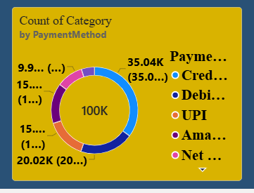
Which payment method is used most frequently?
This donut chart shows the frequency of different payment methods.
The largest section represents the payment method used most frequently.
This helps us understand customer payment preferences.

Slide 19
PROJECT PRESENTATION
KPI Analysis
01
Total Sales – Measures overall
06
Total Products – Measures the
revenue generated.
number of products.
02
Total Orders – Measures the number
Product Sales – Measures product
07
of orders.
sales.
03
Total Quantity – Measures total units
Product Quantity – Measures units
08
sold.
sold.
04
Average Order Value – Measures
09
Average Product Price – Measures
average value per order.
average product price.
05
Cancelled Orders – Tracks cancelled
Returned Orders – Tracks returned
10
orders.
orders.
10 / 16

Slide 20
PROJECT PRESENTATION
Interactive Features
The dashboard contains interactive slicers.
S
Sales Dashboard
P
Product Dashboard
Year
Month
Brand
Year
City
Month
BENEFITS
Easy data exploration.
Quick comparison.
Dynamic analysis.
User-friendly dashboard.
Faster decision-making.
11 / 16

Slide 21
PROJECT PRESENTATION
Key Insights
01
Analyze overall
02
Identify monthly
03
Compare different
sales performance.
and yearly sales
categories.
trends.
04
Analyze order
05
Identify top-selling
06
Compare brand
status.
products.
performance.
07
Analyze city-wise
08
Understand
09
Monitor cancelled
sales.
payment methods.
and returned
orders.
12 / 16

Slide 22
PROJECT PRESENTATION
Business Benefits
01
Monitor sales performance.
05
Analyze geographical sales.
02
Track product demand.
06
Monitor cancellations and returns.
03
Identify high-performing
products.
07
Understand customer payment
preferences.
04
08
Support data-driven decision-making.
Compare brands and categories.
13 / 16

Slide 23
PROJECT PRESENTATION
Conclusion
01
The dashboard provides a clear
02
Power BI was used to create
view of Amazon sales and product
interactive visual reports.
performance.
03
KPIs and charts make data
04
The Sales page focuses on overall
analysis easier.
sales and orders.
05
The Product page focuses on
06
This project improved my skills in
products, brands, cities, and
Power BI, data visualization, KPI
payments.
analysis, and dashboard
development.
14 / 16

Slide 24
PROJECT PRESENTATION
Future Scope
01
Customer-level
02
Profit and profit
03
Customer
analysis.
margin analysis.
segmentation.
04
Regional
05
Sales forecasting.
06
Advanced DAX
performance
measures.
comparison.
07
Automated data
08
Drill-through
09
Mobile-friendly
refresh.
reports.
dashboard.
15 / 16

Slide 25
THANK YOU
Thank you for giving me the opportunity to
present my project.
Presented by:
Divyabharathi.E
16 / 16

